Slide 1
ARCHITECTURE DIAGRAM
MINOR PROJECT

Slide 2
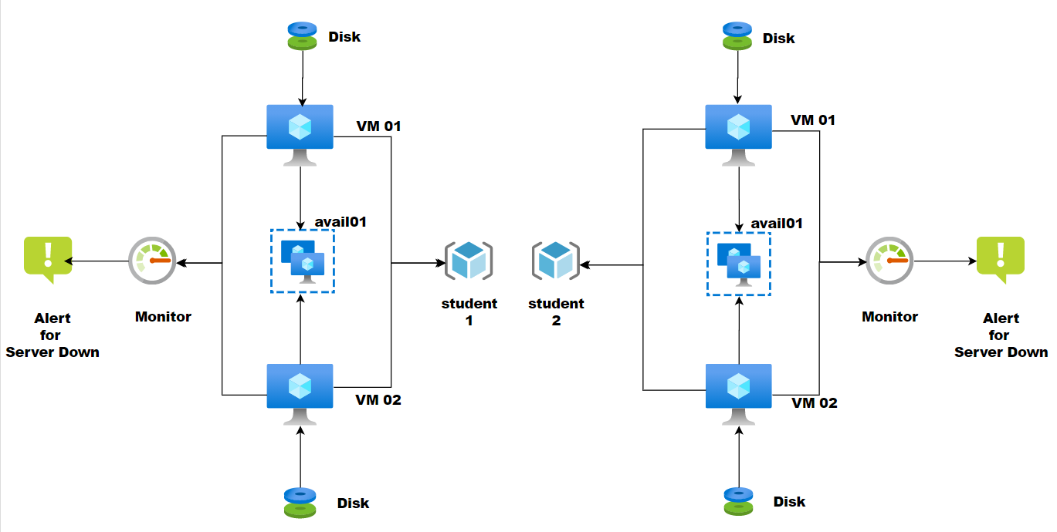

Slide 3
THANK YOU
Aarish Ahmed Siddique

